Slide 1




Autonomous Mobile Robot
For Conventional Wheelchairs Transportation In Healthcare Institutions
João M. Faria
António H. J. Moreira
Viana do Castelo, 22 June 2022
1

Slide 2
00
Summary
00
01
02
03
04
05
01 Introduction
03 Methodology
05 Conclusion
01
02
03
04
05
Introduction
Study Justification
Methodology
Tests and Validation
Conclusion
02 Study Justification
04 Tests and Validation
1

Slide 3
00
Summary
00
01
02
03
04
05
01 Introduction
03 Methodology
05 Conclusion
01
02
03
04
05
Introduction
Study Justification
Methodology
Tests and Validation
Conclusion
02 Study Justification
04 Tests and Validation
1

Slide 4
00
Summary
01 Introduction
03 Methodology
05 Conclusion
01
02
03
04
05
Introduction
Study Justification
Methodology
Tests and Validation
Conclusion
02 Study Justification
04 Tests and Validation
1

Slide 5
00
Summary
2

Slide 6

00
Summary
01 Introduction
2

Slide 7

00
Summary
01 Introduction
02 Study Purpose
2

Slide 8
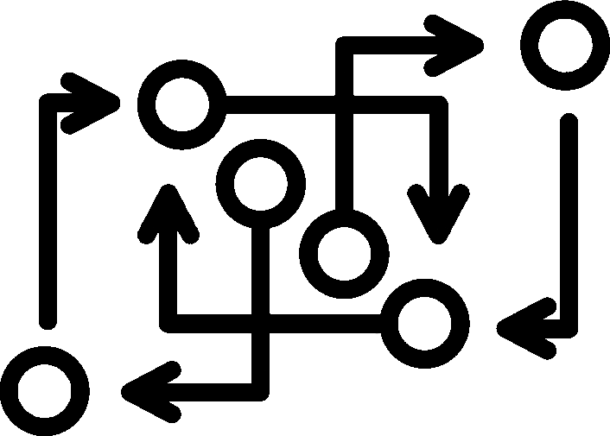
00
Summary
01 Introduction
03 Methodology
02 Study Purpose
2

Slide 9

00
Summary
01 Introduction
03 Methodology
02 Study Purpose
04 Testing and Validation
2

Slide 10

00
Summary
01 Introduction
03 Methodology
05 Conclusion
02 Study Purpose
04 Testing and Validation
2

Slide 11




01
Introduction
AMR (Autonomous Mobile Robot)
Conventional Wheelchair
Industry 4.0
Health Institutions
1

Slide 12




01
Introduction
Industry 4.0
Health Institutions
AMR (Autonomous Mobile Robot)
Conventional Wheelchair
1

Slide 13
01
Introduction
3

Slide 14
01
Introduction
Industry 4.0
3

Slide 15
01
Introduction
Industry 4.0
AMR (Autonomous Mobile Robot)
3

Slide 16
01
Introduction
Industry 4.0
Health Institutions
AMR (Autonomous Mobile Robot)
3

Slide 17
01
Introduction
Industry 4.0
Health Institutions
AMR (Autonomous Mobile Robot)
Wheelchairs
3

Slide 18

01
Introduction
Industry 4.0
Health Institutions
High Custs
AMR (Autonomous Mobile Robot)
Wheelchairs
3

Slide 19


01
Introduction
AMR + Wheelchair + Patient + Safety System
Conventional Wheelchair
Health Institutions
1

Slide 20


01
Introduction
AMR + Wheelchair + Patient + Safety System
03 Methodology
05 Conclusion
02 Study Objective
04 Tests and Validation
1

Slide 21
01
Study Purpose
4

Slide 22
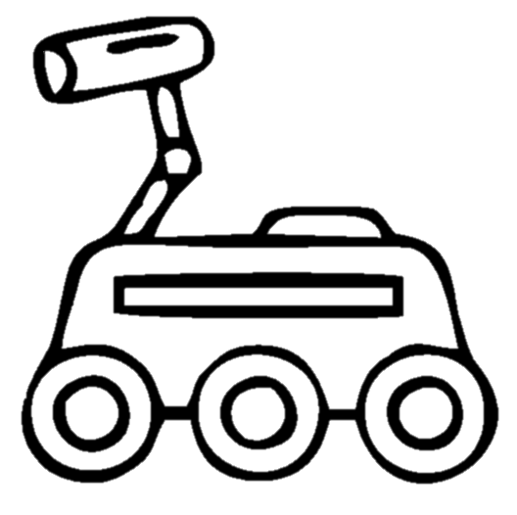

01
Study Purpose
AMR + Wheelchair + Patient + Safety System
4

Slide 23
01
Study Purpose
AMR + Wheelchair + Patient + Safety System
Health Institutions
4

Slide 24

01
Study Purpose
AMR + Wheelchair + Patient + Safety System
Scientifically Important
Health Institutions
4

Slide 25

01
Study Purpose
AMR + Wheelchair + Patient + Safety System
Scientifically Important
Health Institutions
Socially Important
4

Slide 26


02
Study Justification
AMR (Autonomous Mobile Robot)
Conventional Wheelchair
Industry 4.0
Health Institutions
1

Slide 27





03
Methodology
1. Human Machine Interface
2. Health Institution Management System
The application where nurses and doctors will be able to request the transport of the AMR.
Communication with the institution's institutional system is essential to know information such as: which patient is transported, who requests transport, and the various destinations such as treatment or diagnostic areas, outdoors, etc.
3. Wheelchair Transporter Robot
Autonomous Mobile Robot (AMR)
Used to attach the coupling system.
Type of transport
Easy-to-fit, fast, autonomous, and universal coupling mechanism, because there is a diversity of wheelchairs.
Coupling system
Central coupling – pulling the wheelchair
Coupling from below – lifting the wheelchair
Impeller coupling – pushing the wheelchair
Wheelchair + patient
+ safety system
Implementation of a security system consisting of a set of sensors to monitor the patient and act in emergency situations.
5

Slide 28

03
Methodology
1. Human Machine Interface
2. Health Institution Management System
The application where nurses and doctors will be able to request the transport of the AMR.
Communication with the institution's institutional system is essential to know information such as: which patient is transported, who requests transport, and the various destinations such as treatment or diagnostic areas, outdoors, etc.
3. Wheelchair Transporter Robot
Autonomous Mobile Robot (AMR)
Used to attach the coupling system.
Type of transport
Easy-to-fit, fast, autonomous, and universal coupling mechanism, because there is a diversity of wheelchairs.
Coupling system
Central coupling – pulling the wheelchair
Coupling from below – lifting the wheelchair
Impeller coupling – pushing the wheelchair
Wheelchair + patient
+ safety system
Implementation of a security system consisting of a set of sensors to monitor the patient and act in emergency situations.
5

Slide 29
03
Methodology
1. Human Machine Interface
2. Health Institution Management System
The application where nurses and doctors will be able to request the transport of the AMR.
Communication with the institution's institutional system is essential to know information such as: which patient is transported, who requests transport, and the various destinations such as treatment or diagnostic areas, outdoors, etc.
3. Wheelchair Transporter Robot
Autonomous Mobile Robot (AMR)
Used to attach the coupling system.
Type of transport
Easy-to-fit, fast, autonomous, and universal coupling mechanism, because there is a diversity of wheelchairs.
Coupling system
Central coupling – pulling the wheelchair
Coupling from below – lifting the wheelchair
Impeller coupling – pushing the wheelchair
Wheelchair + patient
+ safety system
Implementation of a security system consisting of a set of sensors to monitor the patient and act in emergency situations.
5

Slide 30
03
Methodology
1. Human Machine Interface
2. Health Institution Management System
The application where nurses and doctors will be able to request the transport of the AMR.
Communication with the institution's institutional system is essential to know information such as: which patient is transported, who requests transport, and the various destinations such as treatment or diagnostic areas, outdoors, etc.
3. Wheelchair Transporter Robot
Autonomous Mobile Robot (AMR)
Used to attach the coupling system.
Type of transport
Easy-to-fit, fast, autonomous, and universal coupling mechanism, because there is a diversity of wheelchairs.
Coupling system
Central coupling – pulling the wheelchair
Coupling from below – lifting the wheelchair
Impeller coupling – pushing the wheelchair
Wheelchair + patient
+ safety system
Implementation of a security system consisting of a set of sensors to monitor the patient and act in emergency situations.
5

Slide 31
04
Tests and Validation
The efficiency of the application set, a) management system, and b) transport system in typical use cases.
The effectiveness of the coupling system to the chair
The usability (patient and safety system)
1

Slide 32
04
Testing and Validation
6

Slide 33

04
Testing and Validation
The effectiveness of the coupling system to the chair
6

Slide 34

04
Testing and Validation
The effectiveness of the coupling system to the chair
The usability (patient and safety system)
6

Slide 35

04
Testing and Validation
The effectiveness of the coupling system to the chair
The efficiency of the application set, a) management system, and b) transport system in typical use cases
The usability (patient and safety system)
6

Slide 36
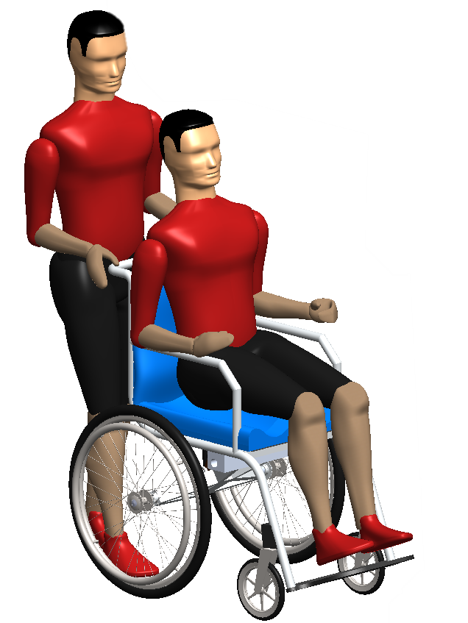
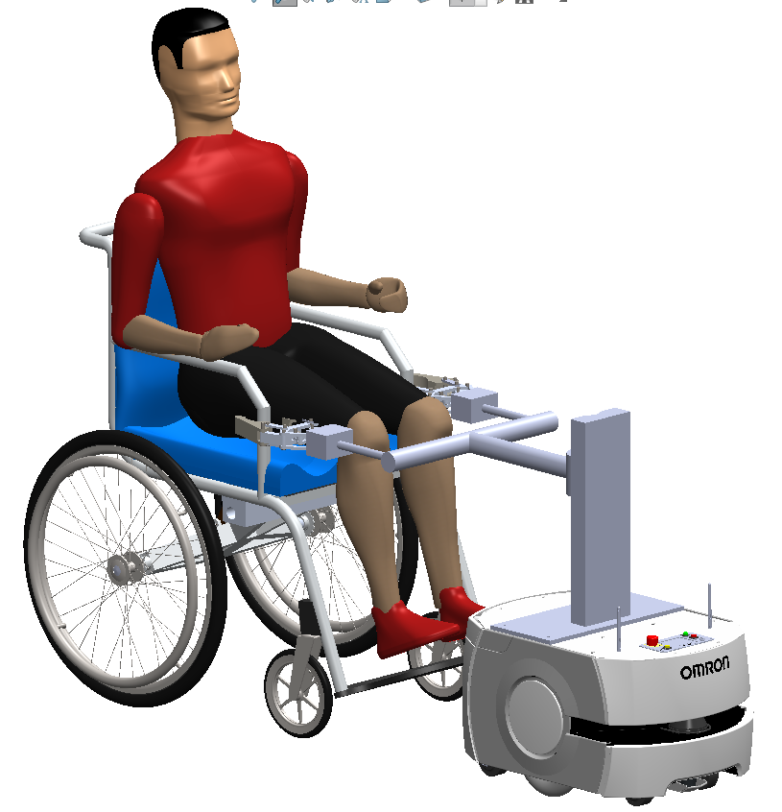
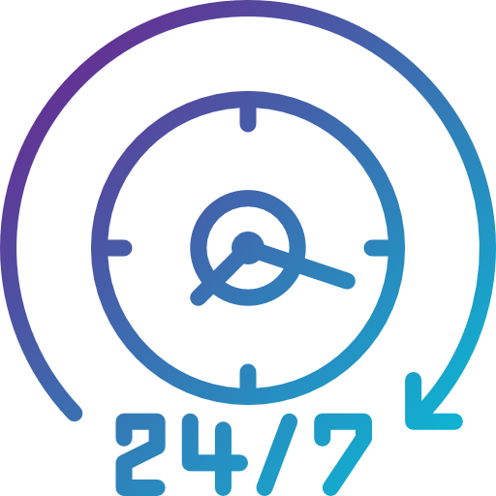
Description | BOM ID
Transport Assistant | 1
Wheelchair | 2
Patient | 3
Safe System | 4
Coupling System | 5
AMR (Autonomous Robot Mobile) | 6
05
Conclusion
1
Advantages
3
3
4
Increasing their availability
2
5
2
6
Reducing the time
Solution Presented
(illustrative picture)
Conventional Transport
1

Slide 37

Description | BOM ID
Transport Assistant | 1
Wheelchair | 2
Patient | 3
Safe System | 4
Coupling System | 5
AMR (Autonomous Robot Mobile) | 6
05
Conclusion
1
Advantages
Increasing their availability
3
3
4
2
5
2
6
Reducing the time
Conventional Transport
Solution Presented
(Illustrative picture
The system is not defined)
1

Slide 38
Description | BOM ID
Transport Assistant | 1
Wheelchair | 2
Patient | 3
Safe System | 4
Coupling System | 5
AMR (Autonomous Robot Mobile) | 6
05
Conclusion
1
Increasing their availability
3
3
4
2
5
2
6
Reducing the time
Conventional Transport
Solution Presented
(Illustrative picture
The system is not defined)
Advantages
1

Slide 39
05
Conclusion
1
Description | BOM ID
Transport Assistant | 1
Wheelchair | 2
Patient | 3
Safe System | 4
Coupling System | 5
Autonomous Robot Mobile | 6
Advantages
3
3
Increasing their availability
4
2
5
2
6
Reducing the time
Conventional Transport
Solution Presented
(Illustrative picture
The system is not defined)
1

Slide 40
05
Conclusion
1
Description | BOM ID
Transport Assistant | 1
Wheelchair | 2
Patient | 3
Safe System | 4
Coupling System | 5
Autonomous Robot Mobile | 6
3
3
4
2
5
2
6
Conventional Transport
Solution Presented
(Illustrative picture
The system is not defined)
7

Slide 41
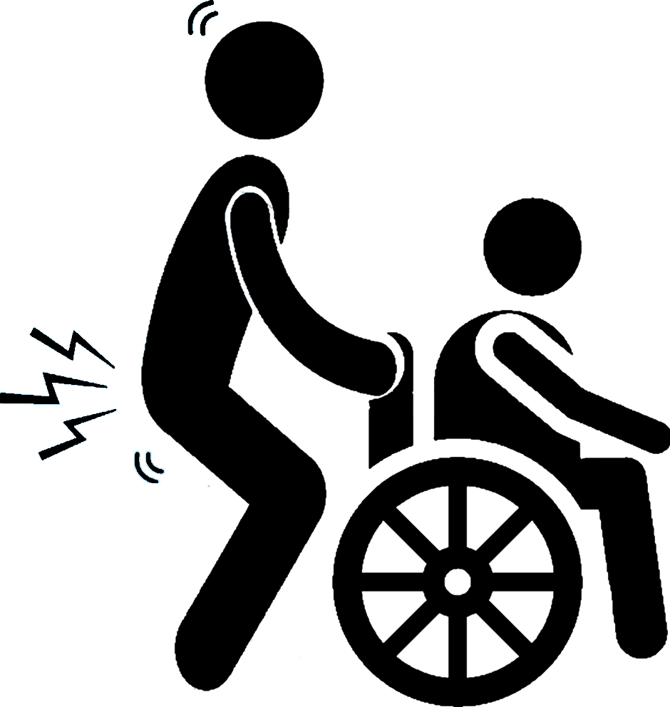

05
Conclusion
1
Description | BOM ID
Transport Assistant | 1
Wheelchair | 2
Patient | 3
Safe System | 4
Coupling System | 5
Autonomous Robot Mobile | 6
Time-consuming
Increasing their availability
Not-ergonomic task
3
3
Reducing the time
Requires the help of assistants
4
2
5
2
6
Conventional Transport
Solution Presented
(Illustrative picture
The system is not defined)
7

Slide 42
06
References
[1] S. Y. Lee, S. C. Kim, M. H. Lee, and Y. I. Lee, “Comparison of shoulder and back muscle activation in caregivers according to various handle heights,” Journal of Physical Therapy Science, vol. 25, no. 10. pp. 1231–1233, 2013, doi: 10.1589/jpts.25.1231.
[2] A. Veerubhotla, K. Tsang, K. James, and D. Ding, “Department of Rehabilitation Sciences and Technology, School of Health and Rehabilitation Sciences, University of Pittsburgh, PA., 2 Human Engineering Research Laboratories, Department of Veteran Affairs Pittsburgh Healthcare System, Pittsburgh, PA,” no. Vm, pp. 7–10.
[3] H. Ikeda, T. Tohyama, D. Maki, K. Sato, and E. Nakano, “Autonomous step climbing strategy using a wheelchair and care robot,” Proc. - 2019 4th Int. Conf. Control. Robot. Cybern. CRC 2019, pp. 75–80, 2019, doi: 10.1109/CRC.2019.00024.
[4] H. Ikeda, Y. Katsumata, M. Shoji, T. Takahashi, and E. Nakano, “Cooperative Strategy for a Wheelchair and a Robot to Climb and Descend a Step,” Advanced Robotics, vol. 22, no. 13–14. pp. 1439–1460, 2008, doi: 10.1163/156855308X360523.
[5] Z. Dai, C. Du, Z. Chen, M. Yuan, and G. Peng, “Design of a New Type of External Traction Device of Wheelchair based on STM32 Chip,” J. Phys. Conf. Ser., vol. 1176, no. 5, 2019, doi: 10.1088/1742-6596/1176/5/052050.
[6] H. Grewal, A. Matthews, R. Tea, and K. George, “LIDAR-based autonomous wheelchair,” SAS 2017 - 2017 IEEE Sensors Appl. Symp. Proc., 2017, doi: 10.1109/SAS.2017.7894082.
[7] O. Mazumder, A. S. Kundu, R. Chattaraj, and S. Bhaumik, “Holonomic wheelchair control using EMG signal and joystick interface,” 2014 Recent Adv. Eng. Comput. Sci. RAECS 2014, pp. 6–8, 2014, doi: 10.1109/RAECS.2014.6799574.
8

Slide 43
06
References
[8] P. E. Hsu, Y. L. Hsu, K. W. Chang, and C. Geiser, “Mobility assistance design of the intelligent robotic wheelchair,” Int. J. Adv. Robot. Syst., vol. 9, pp. 1–10, 2012, doi: 10.5772/54819.
[9] Y. Nasri, V. Vauchey, R. Khemmar, N. Ragot, K. Sirlantzis, and J.-Y. Ertaud, “ROS-based Autonomous Navigation Wheelchair using Omnidirectional Sensor,” Int. J. Comput. Appl., vol. 133, no. 6, pp. 12–17, 2016, doi: 10.5120/ijca2016907533.
[10] N. Rottmann, N. Studt, F. Ernst, and E. Rueckert, “ROS-Mobile: An Android application for the Robot Operating System.” 2020, [Online]. Available: http://arxiv.org/abs/2011.02781.
[11] M. Köseoǧlu, O. M. Çelik, and Ö. Pektaş, “Design of an autonomous mobile robot based on ROS,” IDAP 2017 - Int. Artif. Intell. Data Process. Symp., 2017, doi: 10.1109/IDAP.2017.8090199.
[12] A. R. Baltazar, M. R. Petry, M. F. Silva, and A. P. Moreira, “Autonomous wheelchair for patient’s transportation on healthcare institutions,” SN Appl. Sci., vol. 3, no. 3, pp. 1–13, 2021, doi: 10.1007/s42452-021-04304-1.
[13] “The HL7 Clinical DocumentArchitecture.pdf.” .
[14] “The HL7 Clinical DocumentArchitecture, Release 2.pdf.” .
[15] indoors, “Efficient wheelchair tracking.” https://indoo.rs/always-keep-track-wheelchairs/
9

Slide 44
Thanks
jpfaria@ipca.pt
10

